Slide 1
BASICS OF PYTHON
BASIC SYNTAX |ENVIRONMENT | VARIABLE | TYPES BASIC | OPERATORS DECISION MAKING LOOPS |NUMBERS | STRINGS |LISTS |TUPLES

Slide 2
INTRODUCTION
Python is a general-purpose interpreted, interactive, object-oriented, and high-level programming language. It was created by Guido van Rossum during 1985- 1990. Like Perl, Python source code is also available under the GNU General Public License (GPL). This tutorial gives enough understanding on Python programming language.

Slide 3
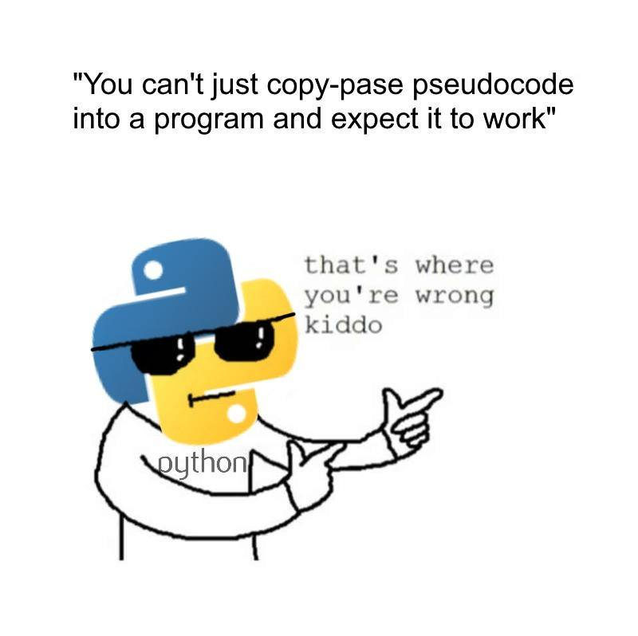
How Flexible is Python?

Slide 4
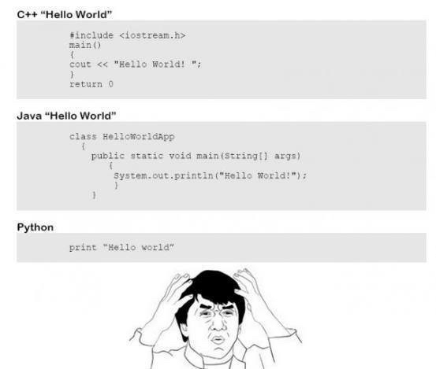
SIMPLICITY

Slide 5
BASIC SYNTAX
PRINTING
ARITHMETIC
OPERATIONS
CONDITIONAL
STATEMENTS
LOOPS
DATA TYPES

Slide 6
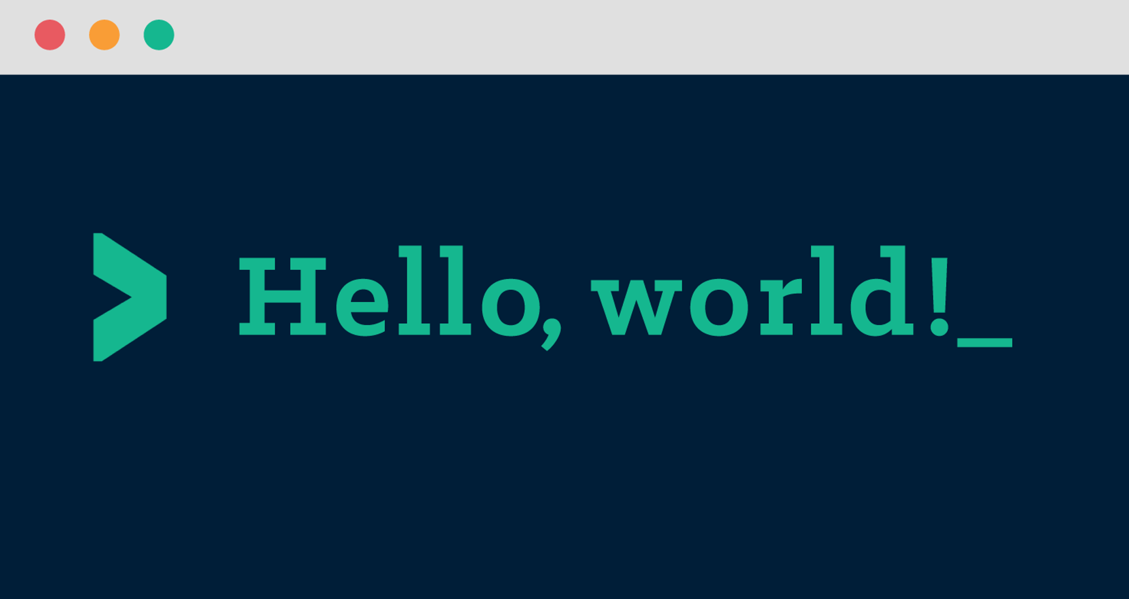
print “HELLO WORLD”

Slide 7

DATA TYPES AND ASSIGNMENT OF VALUES
a = 2 #INT
b = 3.0 #FLOAT
Workshop = “GRC WORKSHOP” #CHAR

Slide 8
ARITHMETIC OPERATIONS
a = 2
b = 3
Sum = a+b
Subtract = a-b
Divide = a/b
Multiply = a*b
Modulo = a%b

Slide 9
PRINTING RESULTS
Variable = 21
Print(“What's 9 plus 10 ? %d ”) % (Variable)
#%s is used for strings and %f for float variables

Slide 10
#HASH
#ARE USED TO IMPLEMENT COMMENTS

Slide 11
DATA TYPES
Numbers
String
List
Tuple
Dictionary

Slide 12
str = 'Hello World!'
print str # Prints complete string
print str[0] # Prints first character of the string
print str[2:5] # Prints characters starting from 3rd to 5th
print str[2:] # Prints string starting from 3rd character
print str * 2 # Prints string two times
print str + "TEST" # Prints concatenated string
The plus (+) sign is the string concatenation operator &
The asterisk (*) is the repetition operator
PYTHON STRINGS

Slide 13
PYTHON LISTS
A LIST CONTAINS ITEMS SEPARATED BY COMMAS AND ENCLOSED WITHIN SQUARE BRACKETS ([]).
TO SOME EXTENT, LISTS ARE SIMILAR TO ARRAYS IN C.
ONE DIFFERENCE BETWEEN THEM IS THAT ALL THE ITEMS BELONGING TO A LIST CAN BE OF DIFFERENT DATA TYPE.

Slide 14
list = [ 'abcd', 786 , 2.23, 'john', 70.2 ]
tinylist = [123, 'john']
print list # Prints complete list
print list[0] # Prints first element of the list
print list[1:3] # Prints elements starting from 2nd till 4th
print list[2:] # Prints elements starting from 3rd element
print tinylist * 2 # Prints list two times
print list + tinylist # Prints concatenated lists
PYTHON LISTS

Slide 15
PYTHON TUPLES
A TUPLE IS ANOTHER SEQUENCE DATA TYPE THAT IS SIMILAR TO THE LIST.
A TUPLE CONSISTS OF A NUMBER OF VALUES SEPARATED BY COMMAS.
UNLIKE LISTS, HOWEVER, TUPLES ARE ENCLOSED WITHIN PARENTHESES.
THE MAIN DIFFERENCES BETWEEN LISTS AND TUPLES ARE:
LISTS ARE ENCLOSED IN BRACKETS ( [ ] ) AND THEIR ELEMENTS AND SIZE CAN BE CHANGED, WHILE TUPLES ARE ENCLOSED IN PARENTHESES ( ( ) ) AND CANNOT BE UPDATED.
TUPLES CAN BE THOUGHT OF AS READ-ONLY LISTS.

Slide 16
tuple = ( 'abcd', 786 , 2.23, 'john', 70.2 )
tinytuple = (123, 'john')
print tuple # Prints complete list
print tuple[0] # Prints first element of the list
print tuple[1:3] # Prints elements starting from 2nd till 3rd
print tuple[2:] # Prints elements starting from 3rd element
print tinytuple * 2 # Prints list two times
print tuple + tinytuple # Prints concatenated lists
tuple[2] = 1000 #invalid
PYTHON TUPLES

Slide 17
NESTED IF STATEMENT
EXAMPLE:
var = 100
if var < 200:
print "Expression value is less than 200"
if var == 150:
print "Which is 150"
elif var == 100:
print "Which is 100"
elif var == 50:
print "Which is 50"
elif var < 50:
print "Expression value is less than 50"
else:
print "Could not find true expression"
print "Good bye!"
if <condition>:
<statement>
elif<condition>:
<statement>
.
.
.
else:
<statement>
CONDITIONAL STATEMENTS

Slide 18
SYNTAX:
for iterating_var in sequence:
statements(s)
EXAMPLE:
for counter in range(1, 6):
print counter
word = "computer"
for letter in word:
print letter
FOR LOOP

Slide 19
Example:
count = 0
while (count < 9):
print 'The count is:', count
count = count + 1
print "Good bye!"
SYNTAX:
while expression:
statement(s)
WHILE LOOP

Slide 20
The import Statement
YOU CAN USE ANY PYTHON SOURCE FILE AS A MODULE BY EXECUTING AN IMPORT STATEMENT IN SOME OTHER PYTHON SOURCE FILE.
THE IMPORT HAS THE FOLLOWING SYNTAX −
import module1[, module2[,... moduleN]

